Slide 1
CSE-325
Practice notes

Slide 2
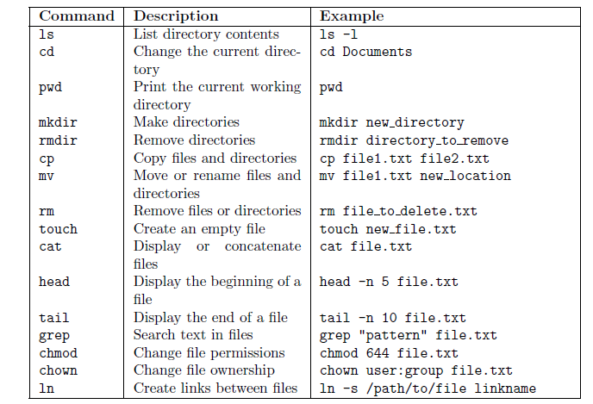
Exeriment-1 Lab List of commands [Table-1]

Slide 3
Needs to practice System calls application, data type and their syntax

Slide 4
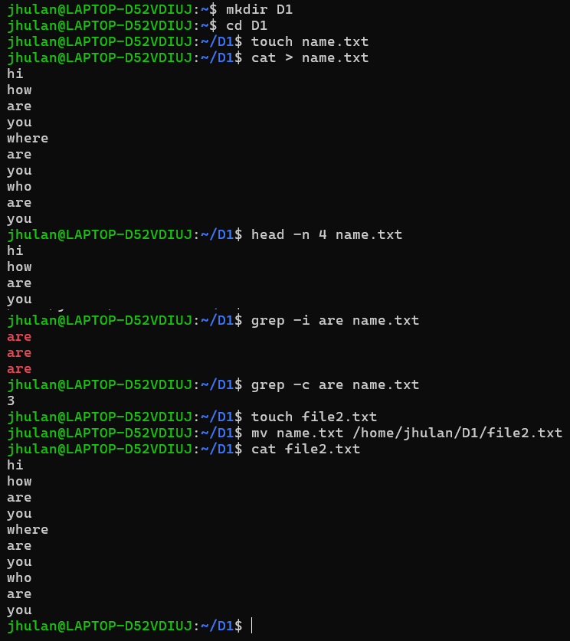

Create a directory D1 and navigate into this directory and create a new file yourname.txt. write something like “ how are you where are you who are you ” using 10 lines. A. Read top 4 lines using head command B. Count are using “grep command”. C. Create a new file name file2.txt and move the content of yourname.txt to file2.txt using MV command. D. Change the access right permission of file2.txt as read-write for user, execute for guest user and read, write, execute for other user.
Note:- Check application/details of command from table -1
Q. D answer here

Slide 5
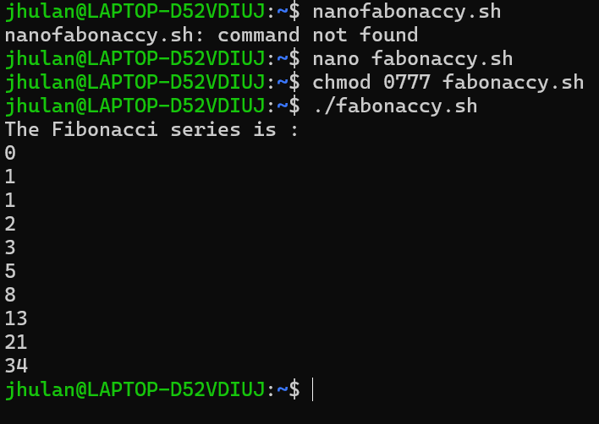
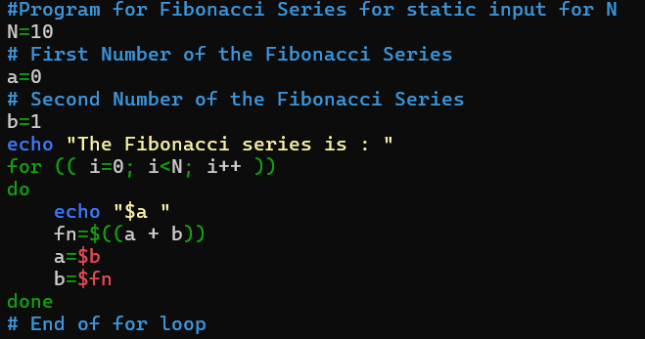
Exeriment-2
Q.1. Write a shell script to generate the Fibonacci series up to a specified number of terms using a for loop.
Solution: - to create a shell script using the nano text editor write command as “nano fabonaccy.sh”.
Note: - After completion of program change the access right using “chmod 0777 fabonaccy.sh” to run it on shell.

Slide 6
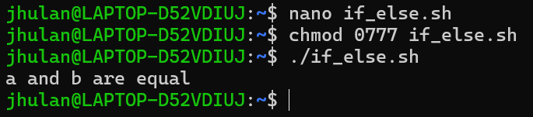
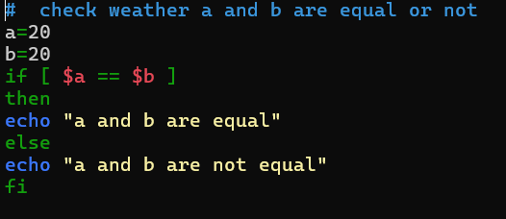
Possible questions:-
Write a shell script that calculates the sum of numbers from 1 to a user-provided value using a for loop.
Write a shell script that calculates the sum of first 10 even number.
Develop a script that checks whether a user-input number is prime or not using a for loop.
Write a shell script that calculates the sum of first 10 odd number.
Write a shell script to perform swap operation between two given number
Write a shell script that compare two number.
Solution of Q.6:-

Slide 7
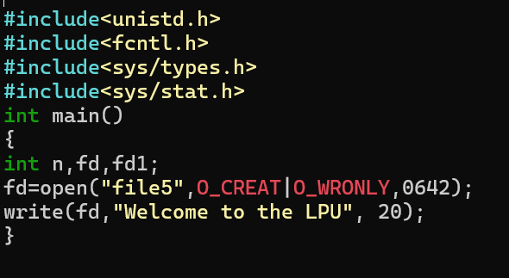
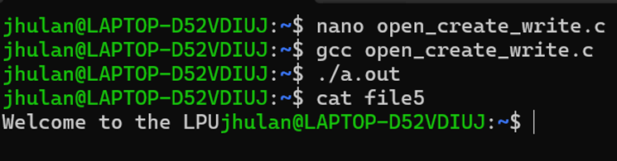
Exeriment-3
Create a file using “open” system call and write welcome to the LPU using “write” system call.

Slide 8
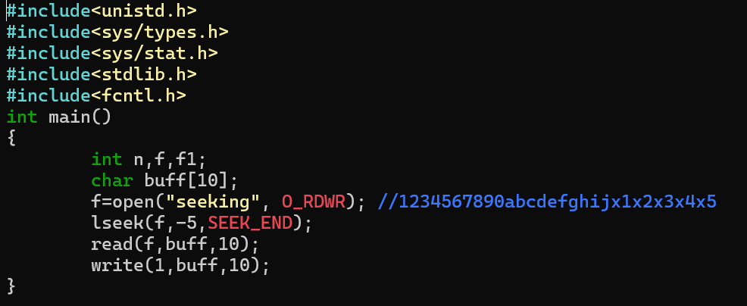
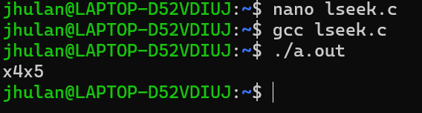
2. Write a c-program to read last 4 character in a file named “seeking” using lseek system call. Seeking contains “1234567890abcdefghijx1x2x3x4x5” inside the file.

Slide 9
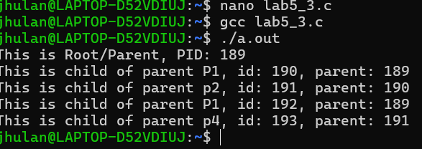
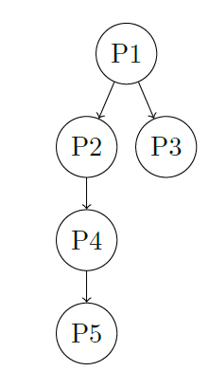
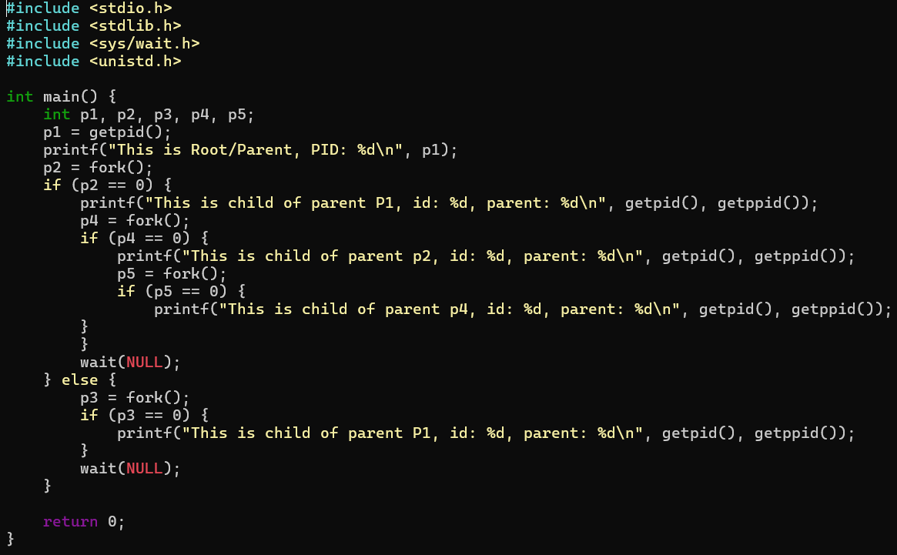
Exeriment-5
Q.1 Write a C program to generate a process hierarchy as follows:
The program should create the specified process structure using the appropriate sequence of ‘fork()‘ system calls. Print PID and PPID of each process.

Slide 10
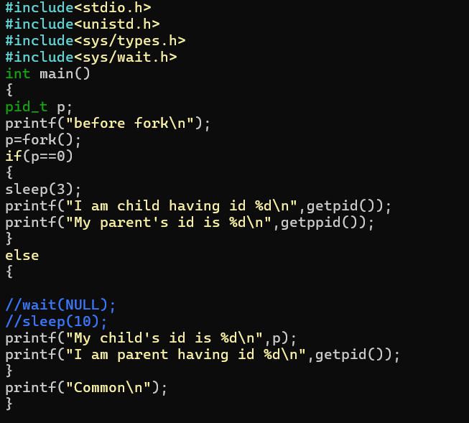
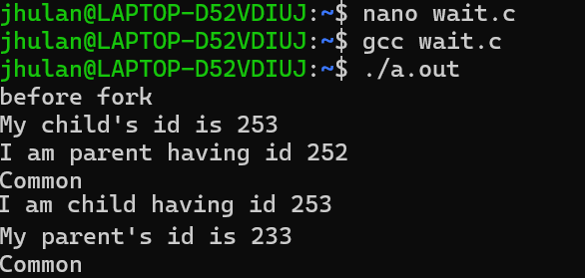
Q.2 Write a c-program to create/demonstrate an orphan process.
Also practice:-
Q.3 Write a c-program using fork so that created child process shouldn’t become orphan
Q.4. Write a c-program to create/demonstrate a Zombie process.
Q.5 Write a c-program using fork that print “Hello” 4 times and “How are you” 8 times.

